Slide 1
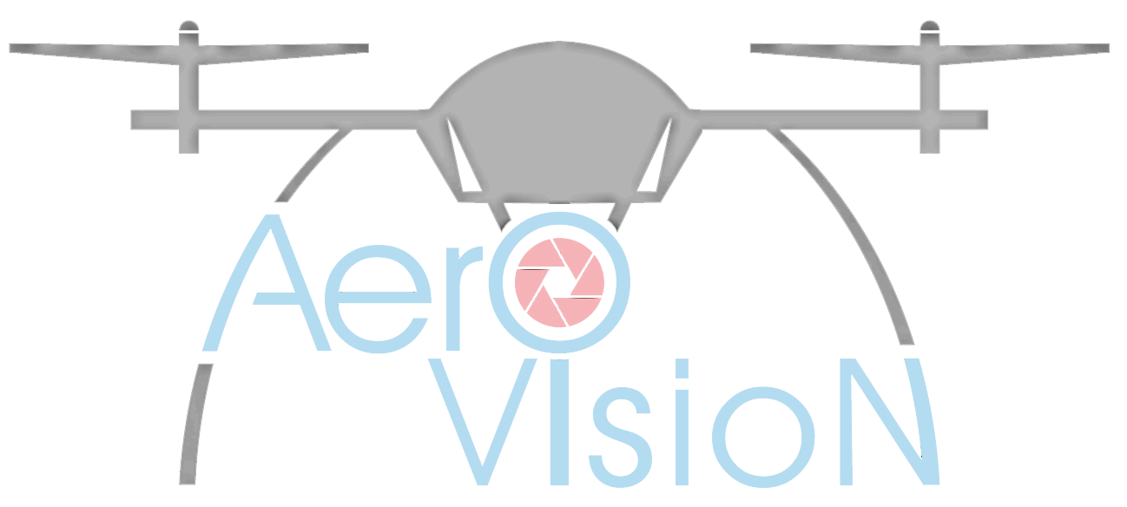
Aero Vision Ltd
Precision drones and advanced uav technologies IN SHIPPING INDUSTRY
Msc. Stanimir nachev

Slide 2
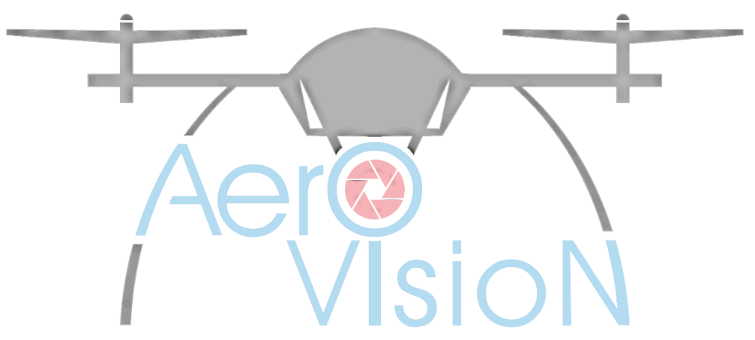
Who we are?
Founded in 2015
One of the fastest growing companies for
unmanned aircraft in Bulgaria
Focused on UAV advanced technologies
Design and manufacturing of products for UAVs
Special training & education for operators / UAV pilots
High precision positioning
NGOs participant and co-founder
FAA / EASA certification

Slide 3
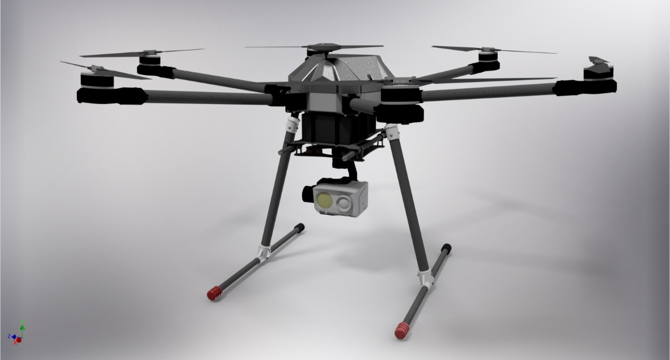
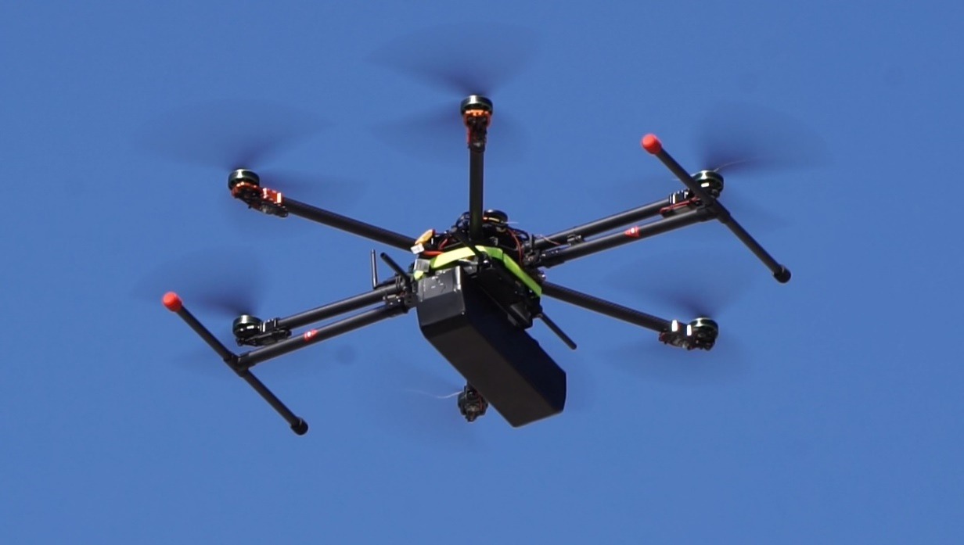
Products
AV-X6 “Scorpion”
18 kg maximum take off weight
Up to 60 min of flight
Up to 5,5 kg payload
Fast deployment
6 rotors with capability of auto land with one faulty engine
Advanced autopilot system with flight planning capabilities
Telemetry, control and video transmission in real time via encrypted connection
Additional options and customized payload available
Suitable for precision farming, monitoring, security and defense
Notes:
-> Following the UAV business, Aero Vision Ltd managed to develop their own strategy of optimizing and improve the available designs of UAVs on the market. That resulted in high efficiency drone and improvement for all of the equipment used on board, like gimbals, telemetry and autopilot system.
->

Slide 4
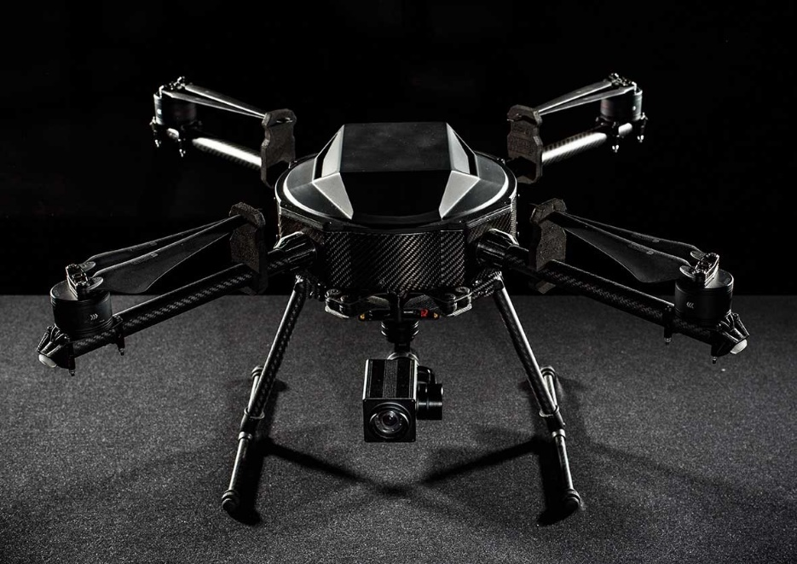
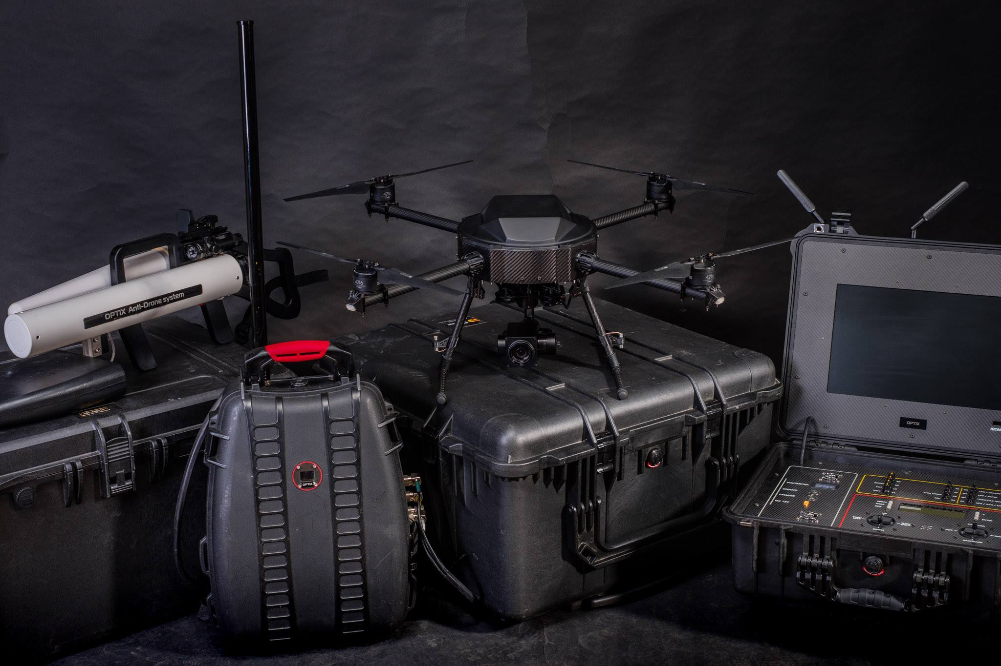
Products
HKR-3 “Hornet”
Up to 40 min of flight
Night and day operations
High zoom thermal and RGB camera
Long range control and telemetry
Payload customization
Advanced autopilot system with flight planning capabilities
Low visibility and noise profile
High end Ground Control Station
Notes:
-> HKR-2 is entirely developed by Bulgarian companies, as the production and assembly is located in Bulgaria. It`s is been developed by Unmanned Inquiries in partnership with Aero Vision. It has the capabilities for:
- Up to 50 min of flight
- Night and day operations
- High zoom thermal and RGB camera
- Long range control and telemetry
- Payload customization
- Advanced autopilot system with flight planning capabilities
- Low visibility and noise profile
- High end Ground Control Station

Slide 5
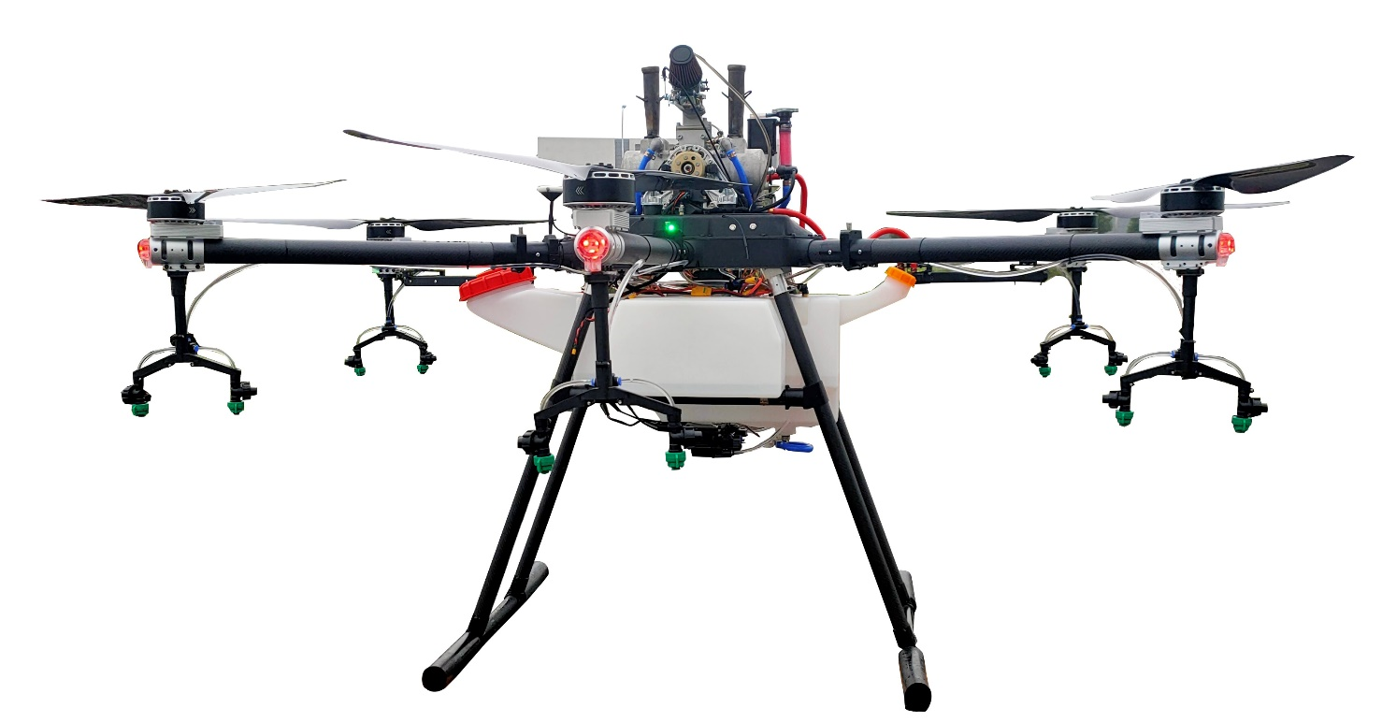
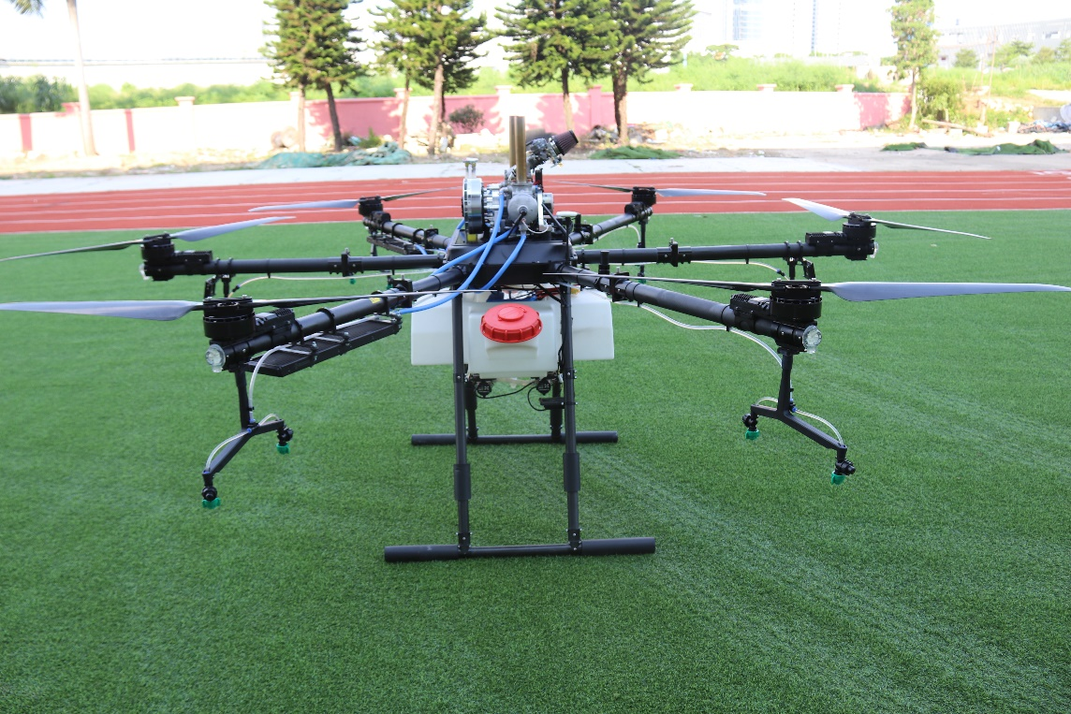
Products
2300
120 kg of maximum TOW
Up to 1 hour effective flight endurance
Up to 60 kg of payload
6 rotors with capability of auto land with one faulty engine
Advanced autopilot system with flight planning capabilities
Full telemetry system
Multiple upgrades and options available
Suitable for different crop treatment and spraying

Slide 6
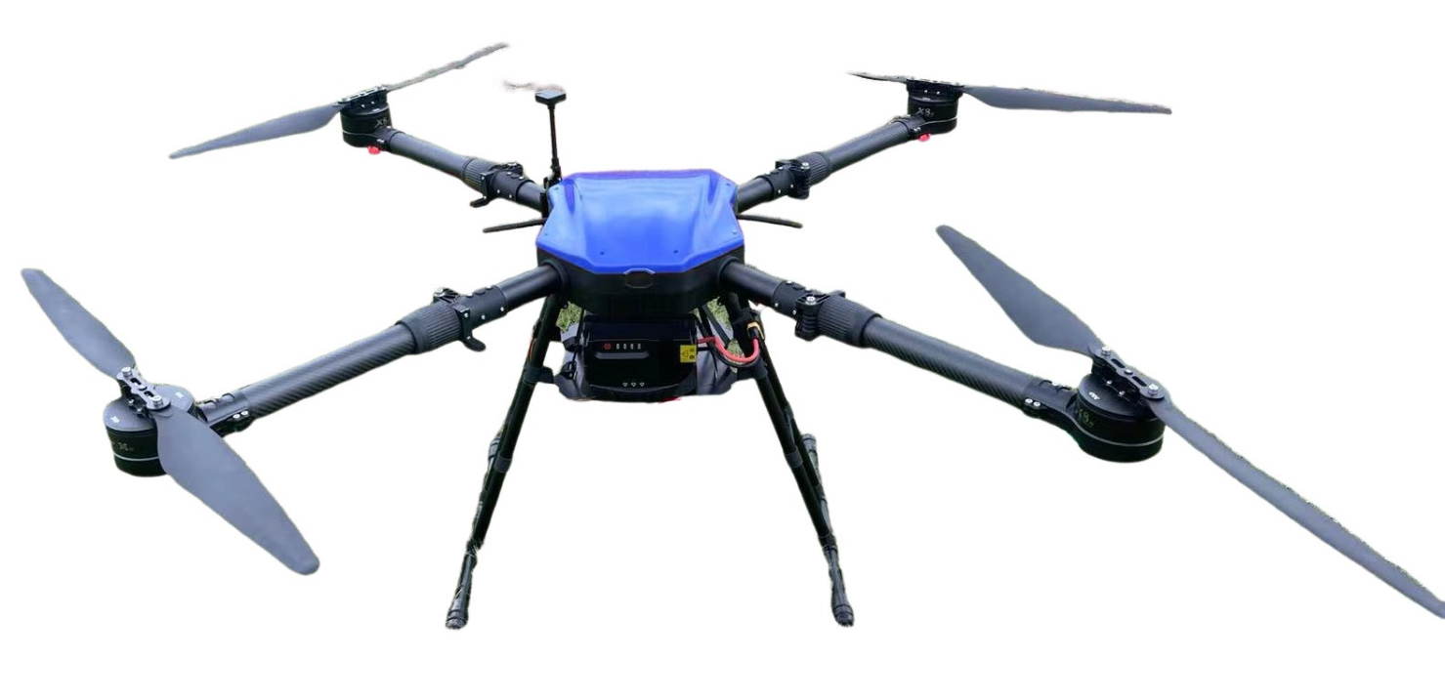
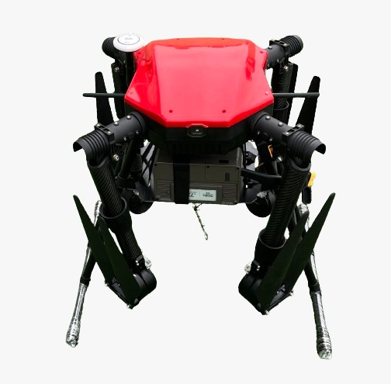
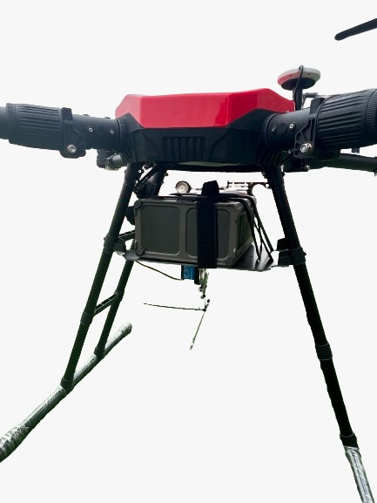
Products
1100
Small size: 1100 mm diameter between the engines
Maximum takeoff weight: 45kg
Up to 60 min of flight
Up to 22 kg payload
Optional payload with 6 points of attachment
4 rotors with capability of auto land with one faulty engine
Advanced autopilot system with flight planning capabilities
Telemetry, control and video transmission in real time via encrypted connection
Additional options and customized payload available

Slide 7
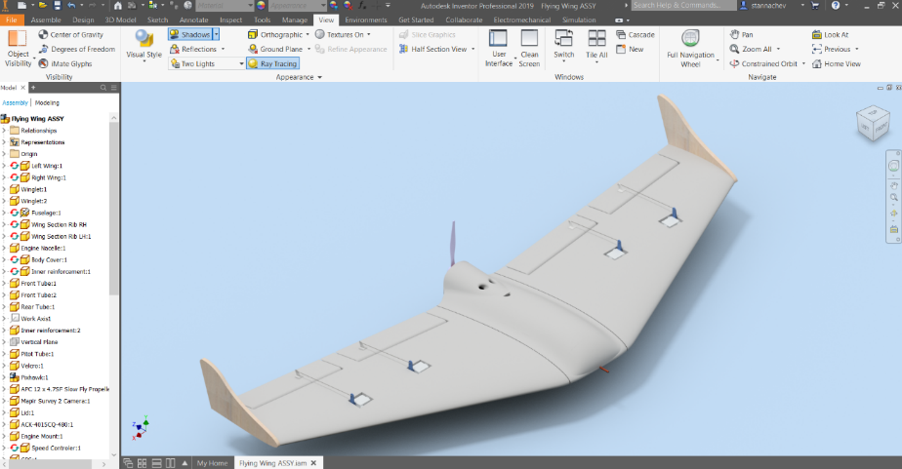
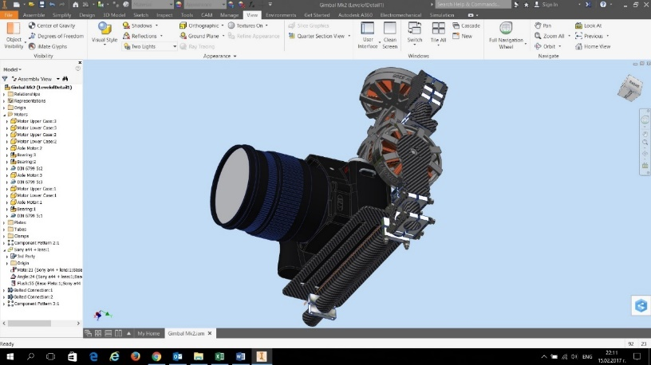
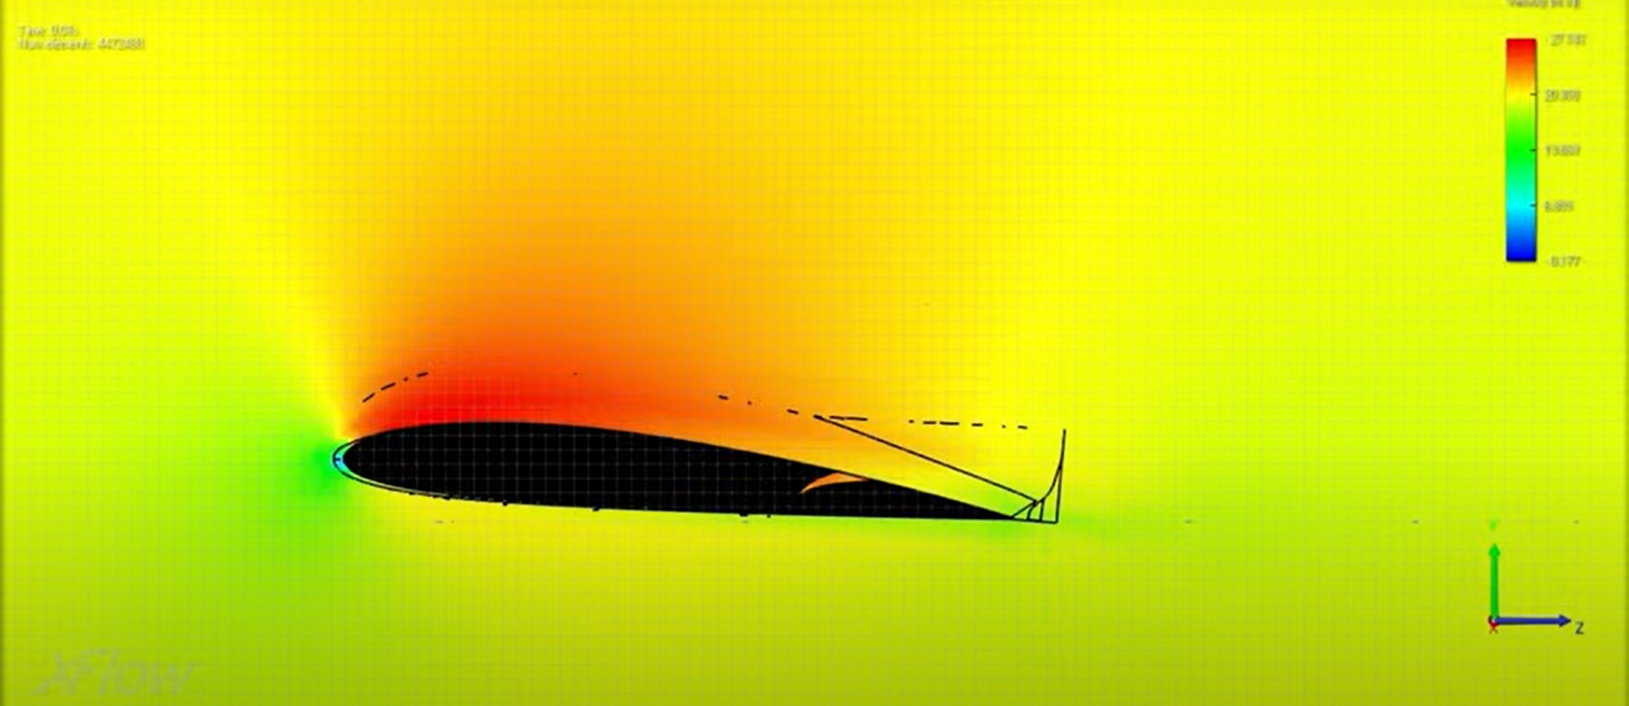
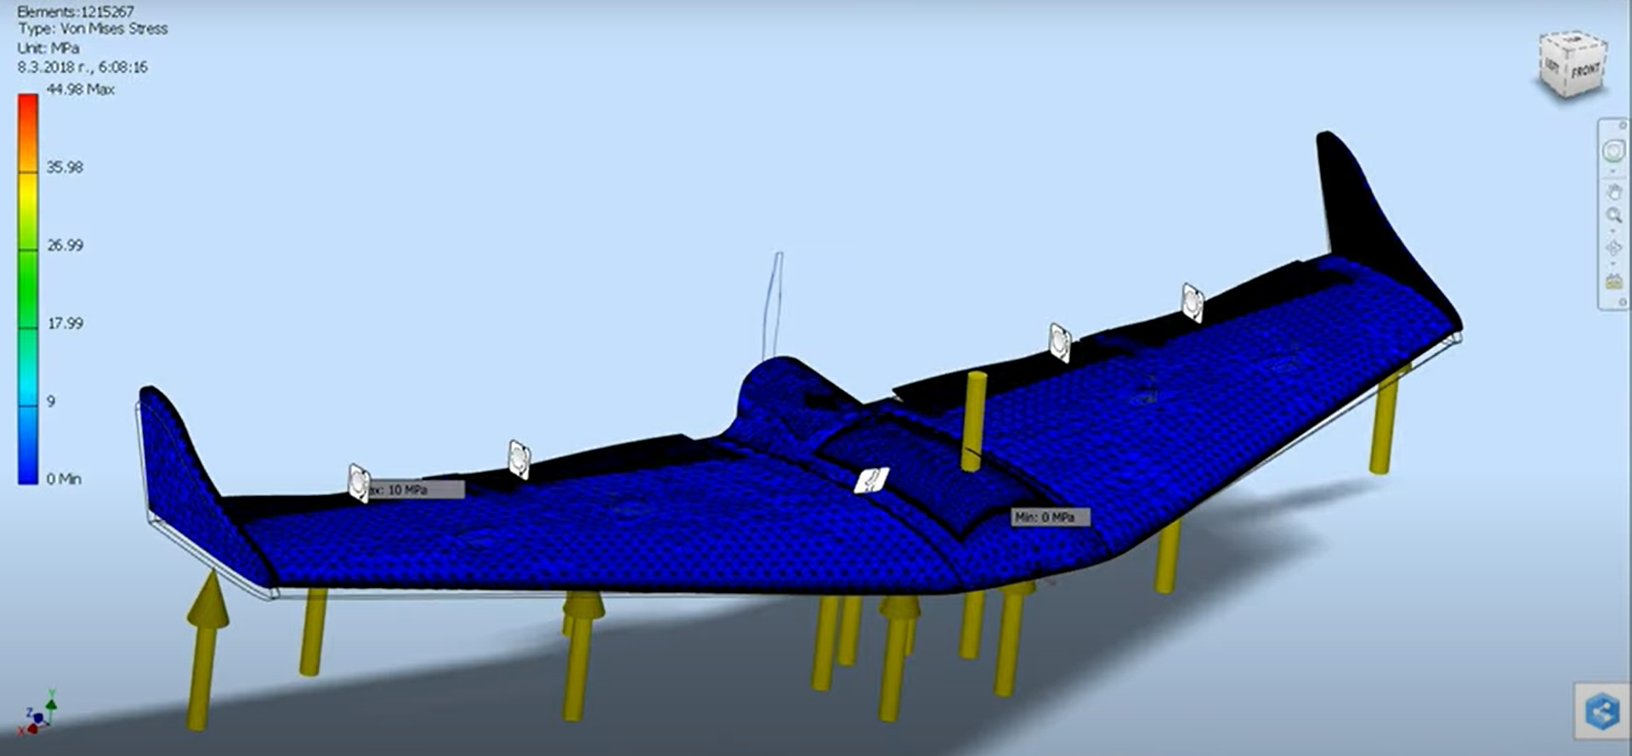
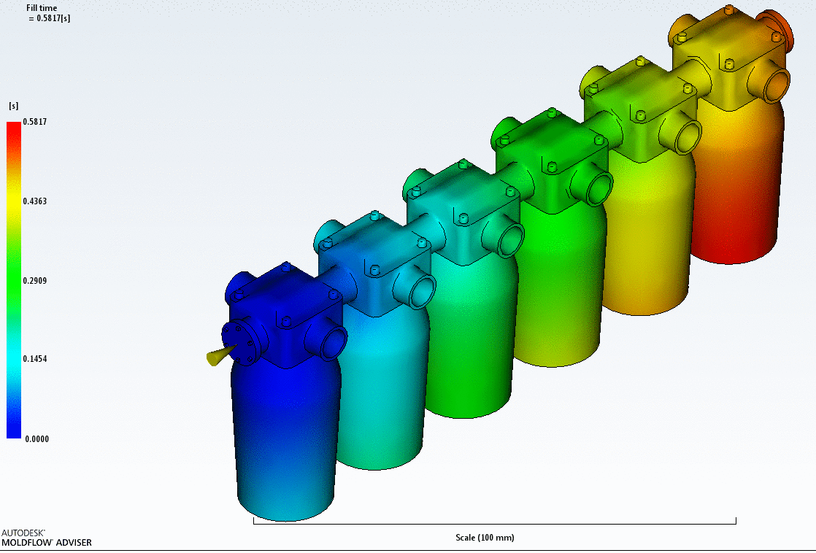
Experience
Design
Design and manufacturing of specialized autonomous vehicles
Optimization of UAV systems and modules
Design of sensors, modules, hardware and software
Design of mechanical components and composite structures
Stress – strain analysis
Modal and non- linear static (contact, material and geometric)
Mold flow simulation
Aerodynamic simulations (Navier-Stokes and Lattice-Boltzmann)
Notes:
-> Some of the available innovations represented by the company, together with Space Research and Technology Institute of Bulgaria is
- Optimizing design and manufacturing using high end 3D modelling software
- Advanced CFD particle based simulation software
Stress / strain analysis
- Advanced technology for postprocessing of data and positioning, based on RTK (Real Time Kinematics) with sub- inch accuracy
- Autopilot programming and coding
- Design and manufacturing of sensors, data link hardware and software for high accuracy positioning
- Optional design and manufacturing of flying wings, gimbals and many others
->

Slide 8
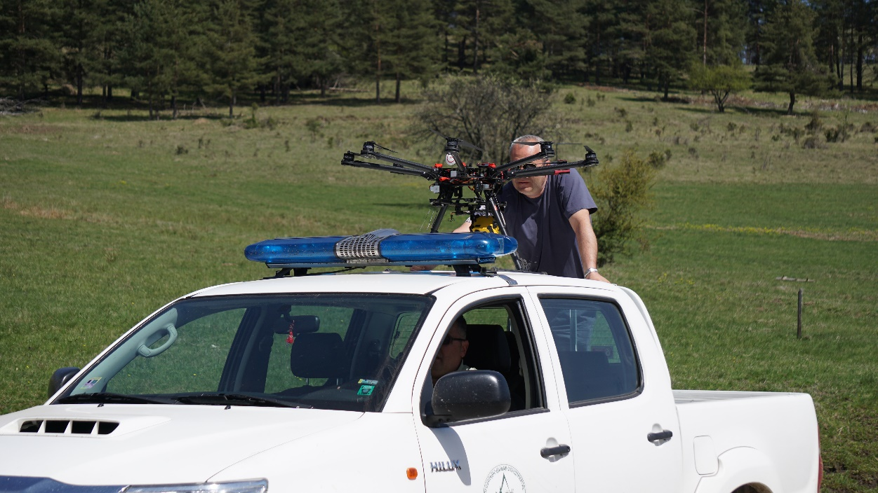
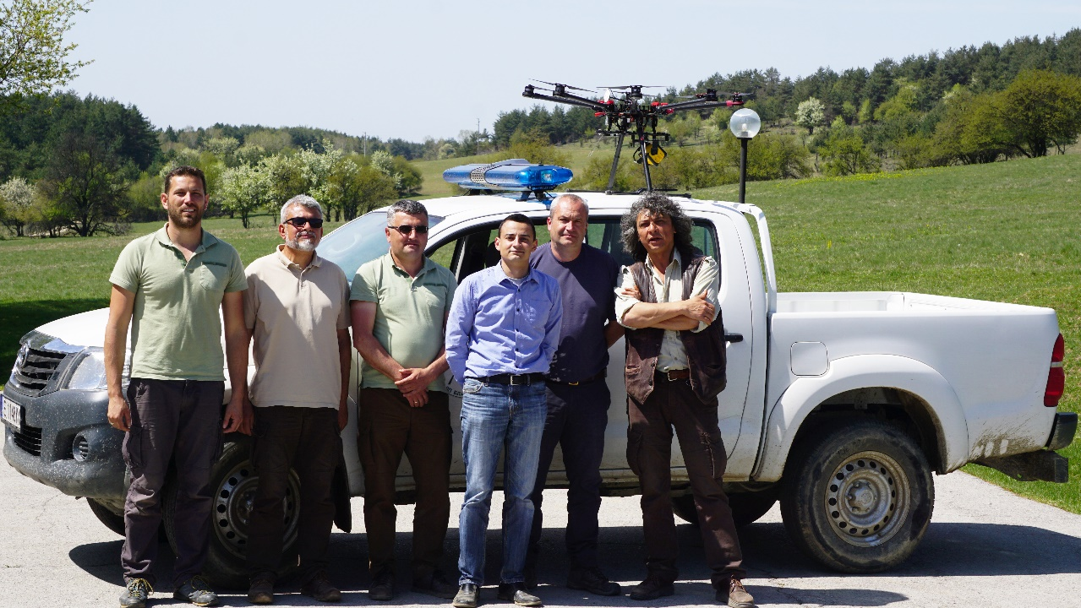
Experience
Special training & education for operators / UAV pilots
Training for the special forces of the police department in Bulgaria
Training of specialist from EOD COF of NATO
Training for the Ministry of Agriculture and Food of Bulgaria
Special training for camera operators
Training for field mapping and crop analysis
Training for auto flight optimization of the UAV
Notes:
-> All of the solutions, regarding the UAV sales and services, are bundled with special training for operators and pilots of UAVs.
Some of the projects in which Aero Vision was involved:
Training for the special forces of the police department in Bulgaria
Training for the Ministry of Agriculture and Food of Bulgaria
Special training for camera operators
Training for field mapping and crop analysis
Training for auto flight optimization of the UAV
->

Slide 9
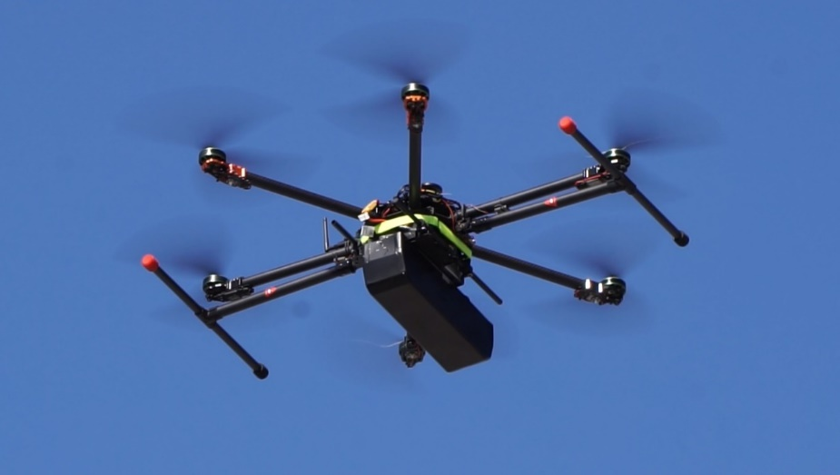
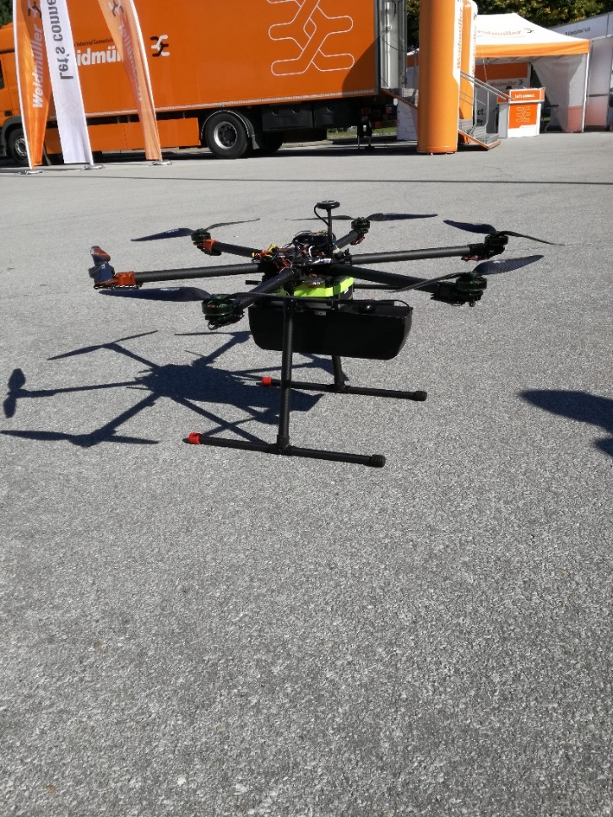
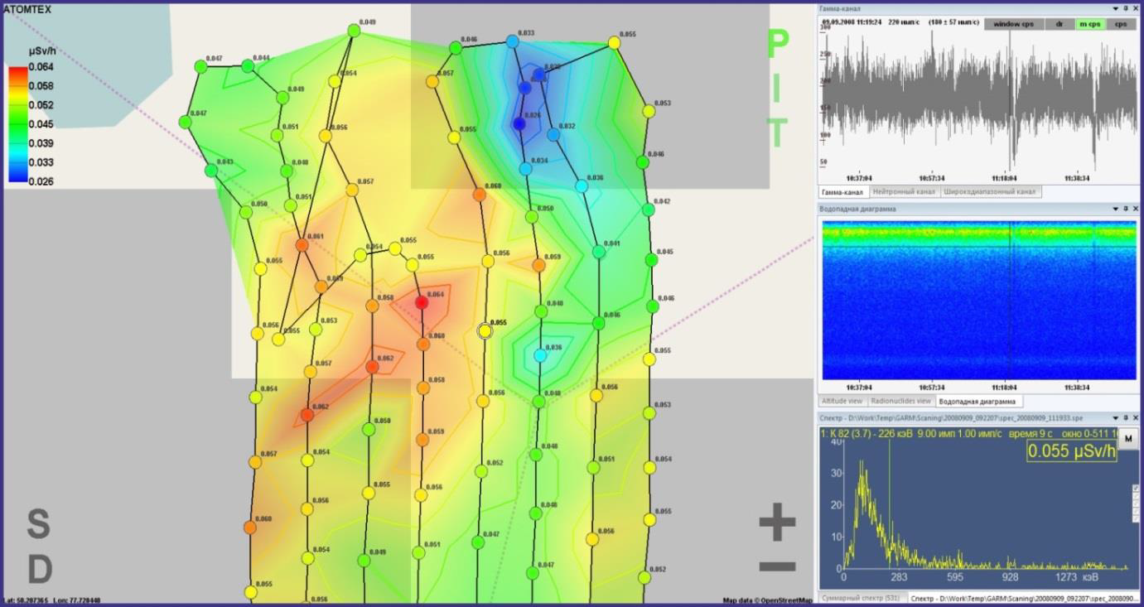
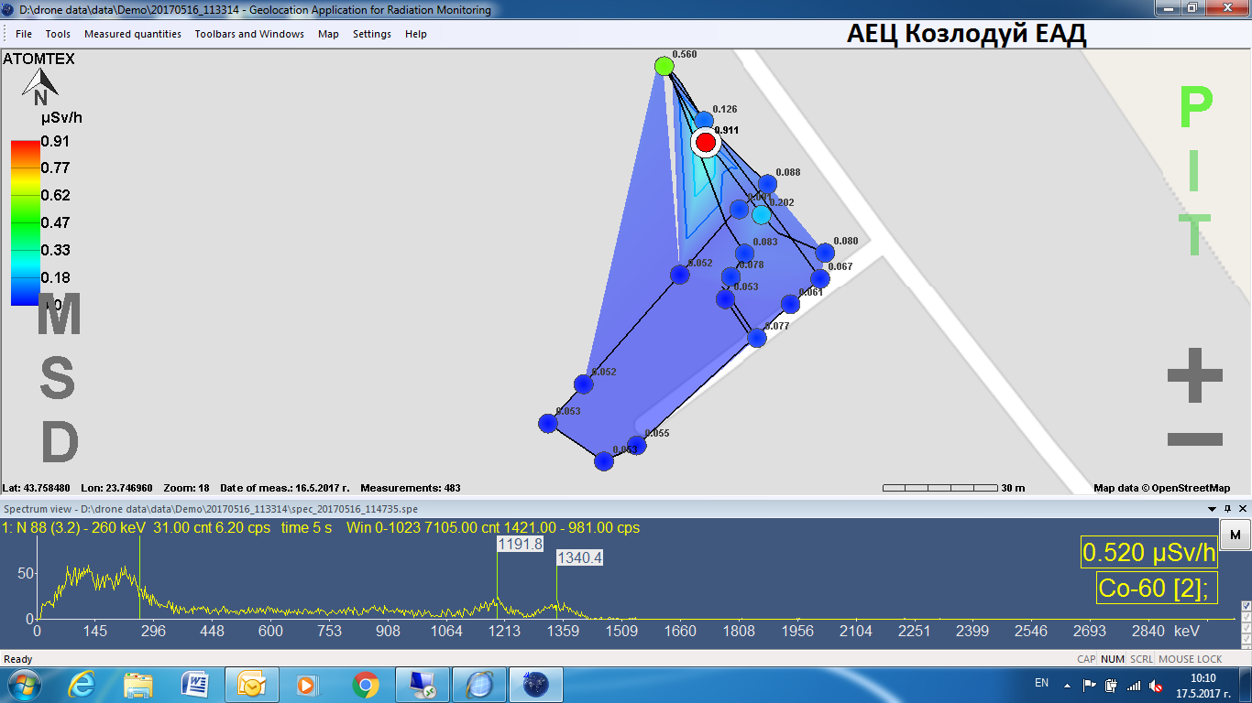
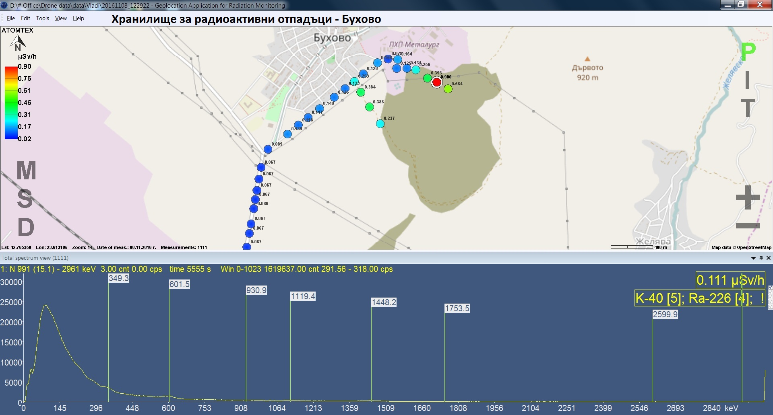
Applications
Radio Activity And Pollution Sensing
Radiation and pollution reconnaissance from the ships and in the area of ports
Researching of sources of radiation and pollution
Spectrometry
Terrain and radio activity and pollution mapping

Slide 10
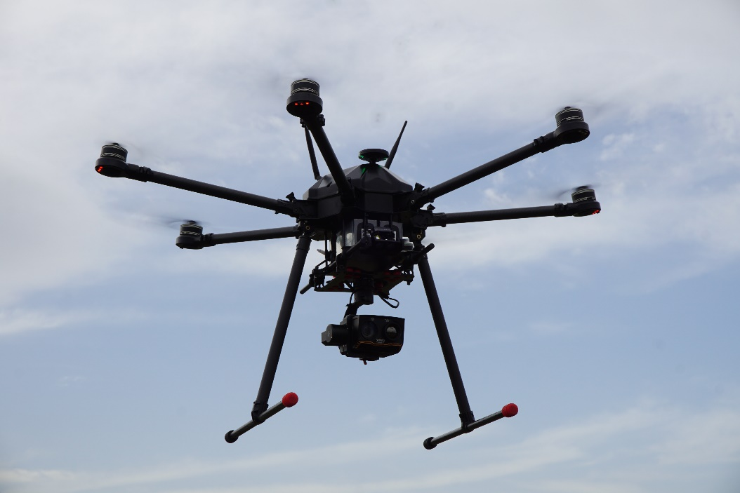
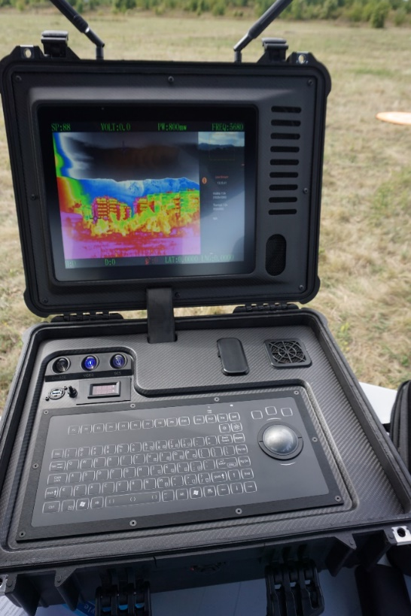
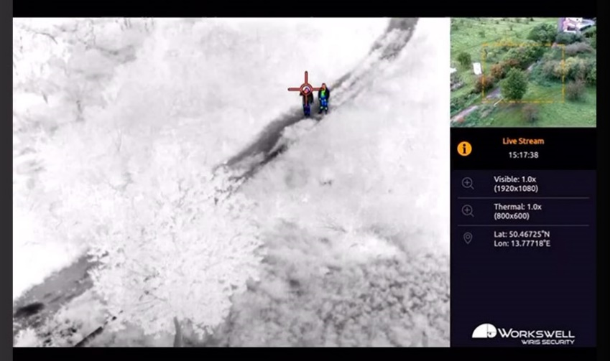
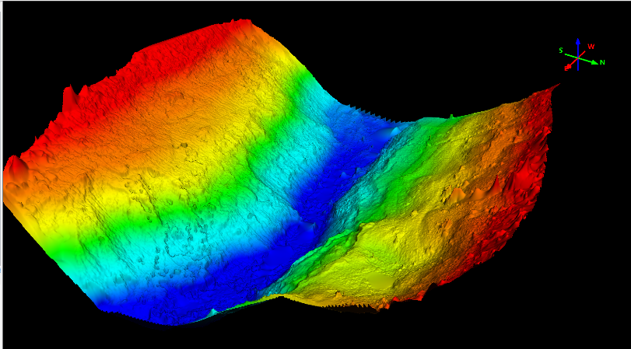
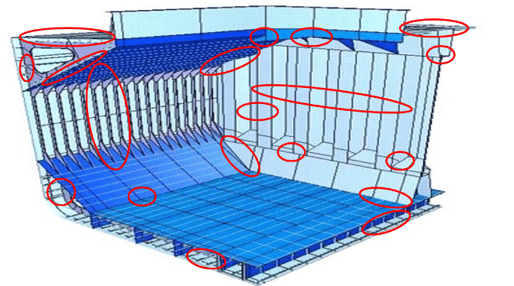
Applications
Security monitoring
Mapping of the shore area
Day and night operations with thermal camera
Fast deployment in remote area
Fully electrical powertrain
Autonomous collecting surface garbage
Inspection of ship`s condition with LiDAR systems
Providing capabilities for delivery of payloads in open sea
Loitering monitions for securing the ships from attacks in open sea
Search and rescue operations

Slide 11
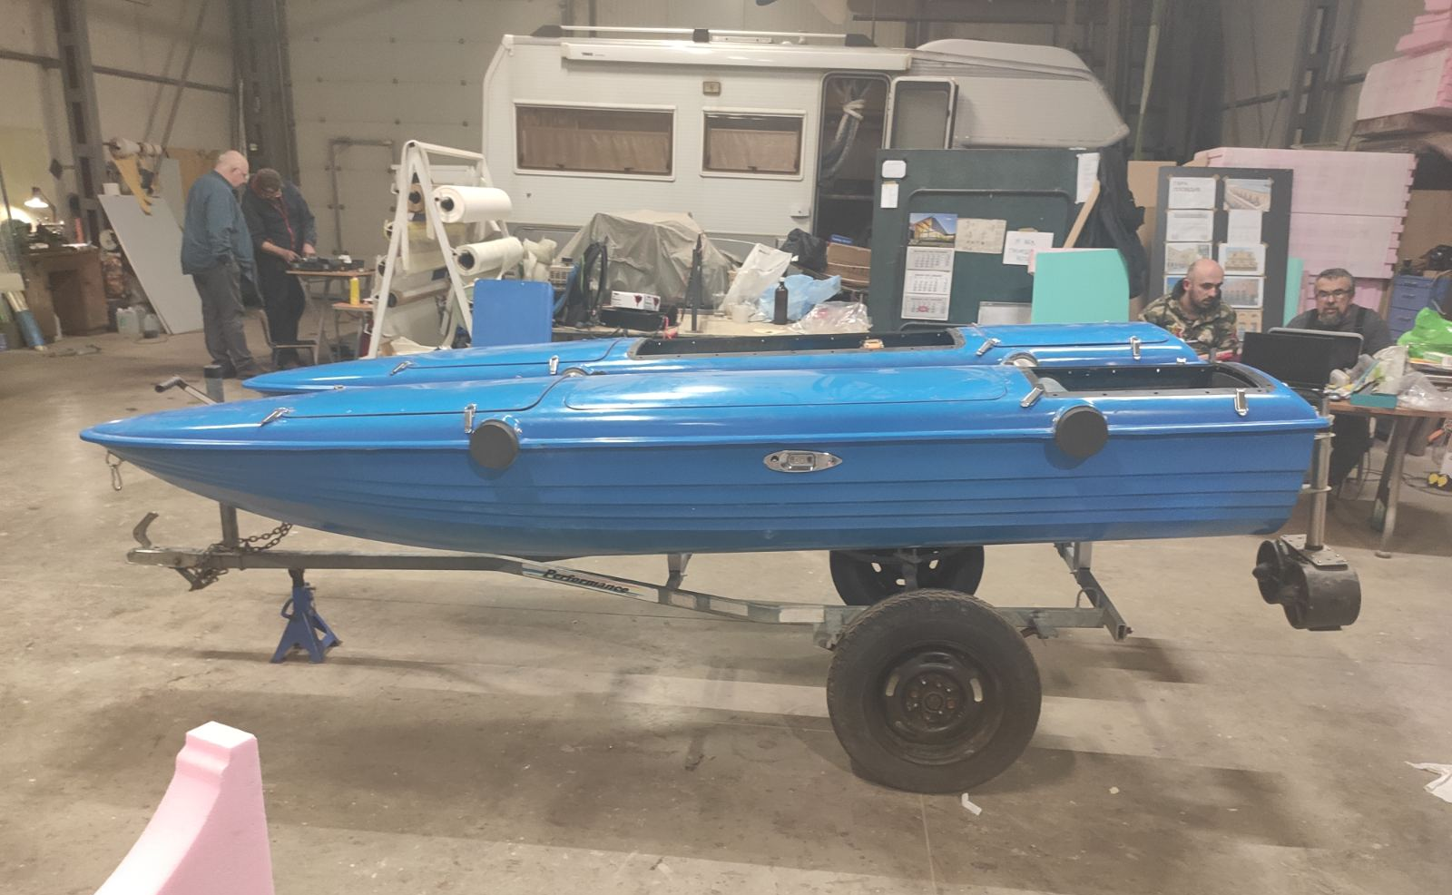
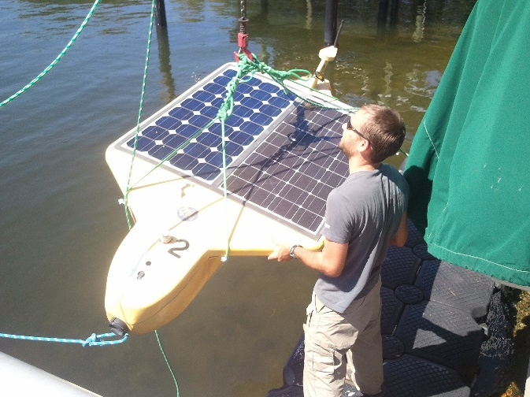
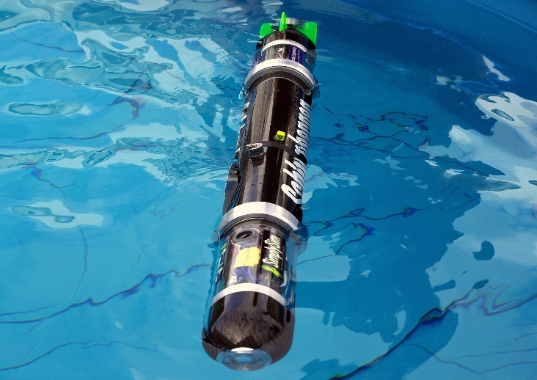
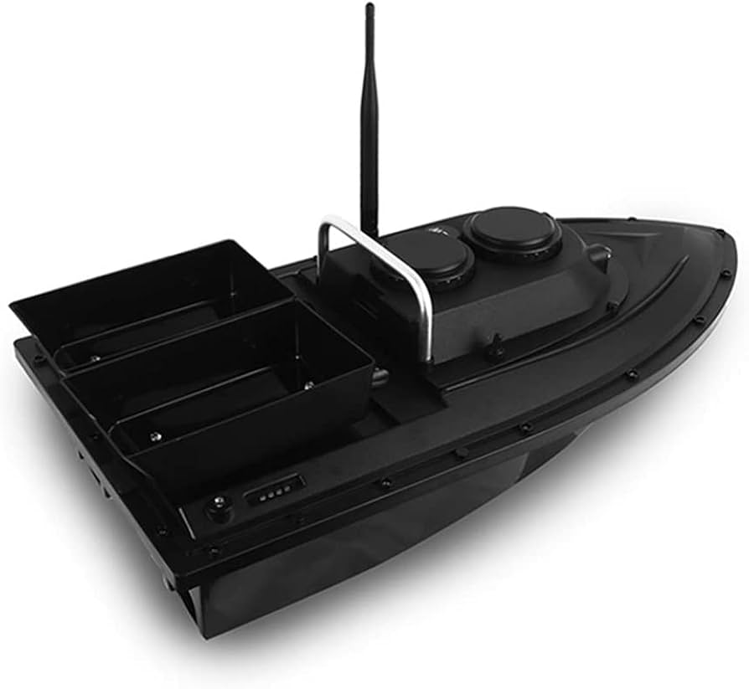
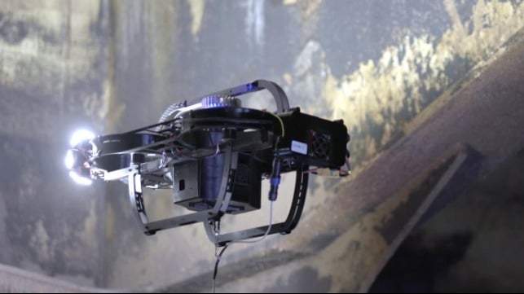
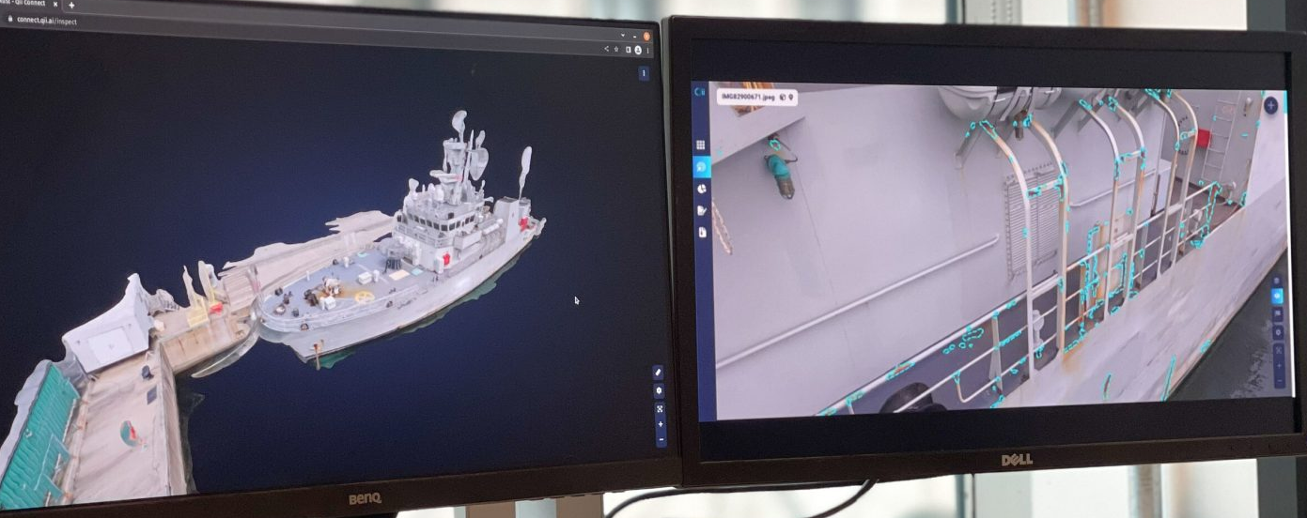
Applications
Water autonomous vehicles
Fully autonomous
Fully electrical powerplant
Autonomous collecting surface garbage
Providing mapping of the sea bottom
Providing valuable data for the pollution in open waters
Underwater ship inspection
Photogrammetry and building accurate 3D models

Slide 12
Partners
Naval Academy “Nikola Vaptsarov”
Technical University of Sofia
Space Research and Technology Institute
Bulgarian Civil Aviation Administration
European Space Agency
ECO PROGRESS Ltd
TOPODRONE
B2N
Leading sensors manufacturers…
… and many other partners all around the Globe
Notes:
Without our partners and supporters, of course, Aero Vision wouldn`t be so successful. They have the important role in our business to provide us with competent advices, trainings and technical support.

Slide 13
“We will either find a way or make one”
Hannibal,
politician, statesman and military commander of ancient Carthage

Slide 14
THANK YOU FOR YOUR ATTENTION!
Stanimir Nachev
General Manager
Mobile: +359 878 47 87 64
e-mail: office@aerovision.bg
Web: [www.aerovision.bg]www.aerovision.bg

